Slide 1
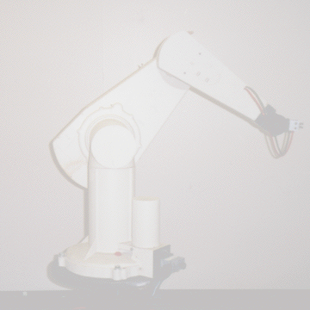
F o r w a r d K i n e m a t i c s
- DH Method

Slide 2
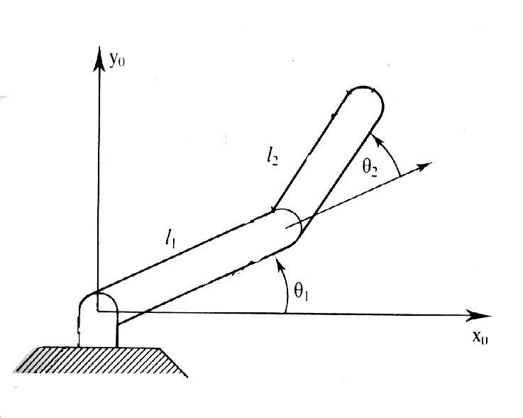
The Situation:
You have a robotic arm that starts out aligned with the x_{o}-axis.
You tell the first link to move by ₁ and the second link to move by ₂.
The Question:
What is the position of the end of the robotic arm?
Solution:
1. Geometric Approach
This might be the easiest solution for the simple situation. However, notice that the angles are measured relative to the direction of the previous link. (The first link is the exception. The angle is measured relative to it’s initial position.) For robots with more links and whose arm extends into 3 dimensions the geometry gets much more tedious.
2. Algebraic Approach
Involves coordinate transformations.

Slide 3
Denavit - Hartenberg Method

Slide 4
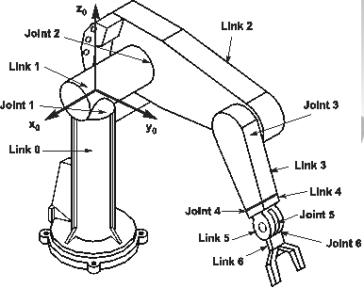
Why DH
A simple and standard way of representing and modeling robots and their motions.
Find the homogeneous transformation H relating the tool frame to the fixed base frame

Slide 5
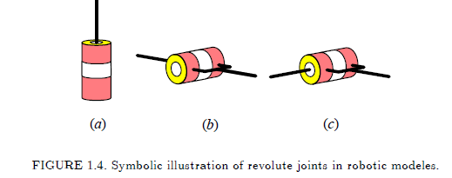
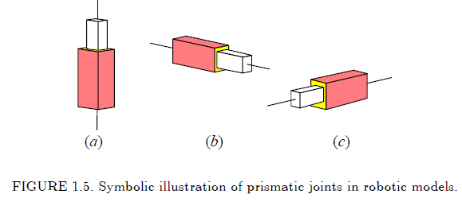

Slide 6
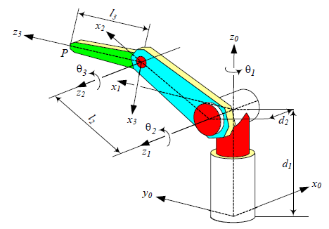
We attach a Cartesian coordinate frame to each link of a robot and determine the position and orientation of each frame with respect to the others. Therefore, to determine the position and orientation of the end effector, we need to find the end-effector frame in the base frame.

Slide 7
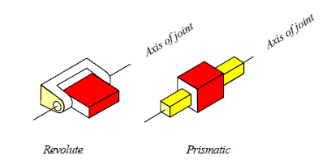
DH Notations
Kinematic Chain from end effector frame B_{n} to base frame B₀
Each joint is assigned to a coordinate frame.

Slide 8
DH Notation
The base frame is frame 0.
A joint and its rigidly attached link have the same index i.
Motion of link i can be done by moving joints i, (i-1),… not joint (i+1).
The coordinate frame B_{i} is fixed to the link i and the coordinate frame B_{i-1} is fixed to the link (i − 1).

Slide 9
DH parameters
Link i connects proximal joints i and distal joint (i+1)
Link i connects frame i-1 and frame i
Four link variables of link i
θ_{i} joint angel: a variable if joint i is R (revolute)
d_{i} joint distance: a variable if joint i is P(prismatic)
α_{i} is twist angle
a_{i} is link offset
cannot change unless reconfigure the robot

Slide 10
DH Notation (repeat)
For n joints: we have n+1 links. Link 0 is the base
Joints are numbered from 1 to n
Frame B_{i} {X_{i} Y_{i} Z_{i}} is attached to the end point of link i, link i is controlled by joint i, not joint (i+1)
Variable parameters θ_{i} and d_{i} for frame i (aka link i) refer to rotation angle and translation distance of joint i, not joint (i+1). (That is why the superscript is i.)
Frame B₀ { X₀ Y₀ Z₀} is attached to the robot base (inertial frame).
Read textbook Chapter 5.1 for notation please.

Slide 11
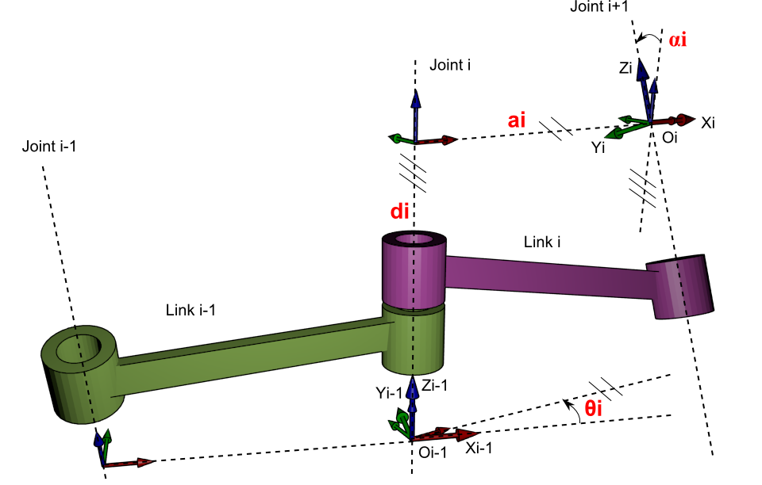

Slide 12
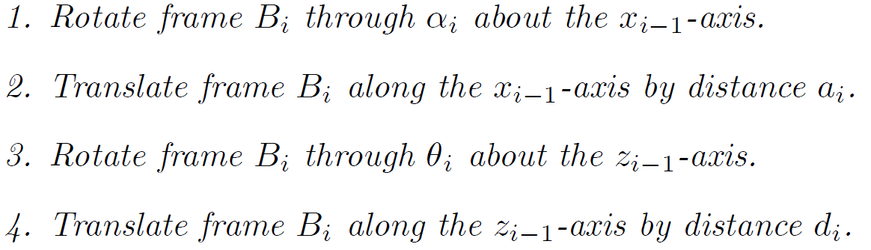
Translation between two adjacent frames from frame B_{i} to B_{i-1}
During these transformations, B_{i-1} acts as the global coordinate frame for the local coordinate frame B_{i}, and these motions are about and along the global axes.

Slide 13
Translation between two adjacent frames from frame B_{i} to B_{i-1}

Slide 14
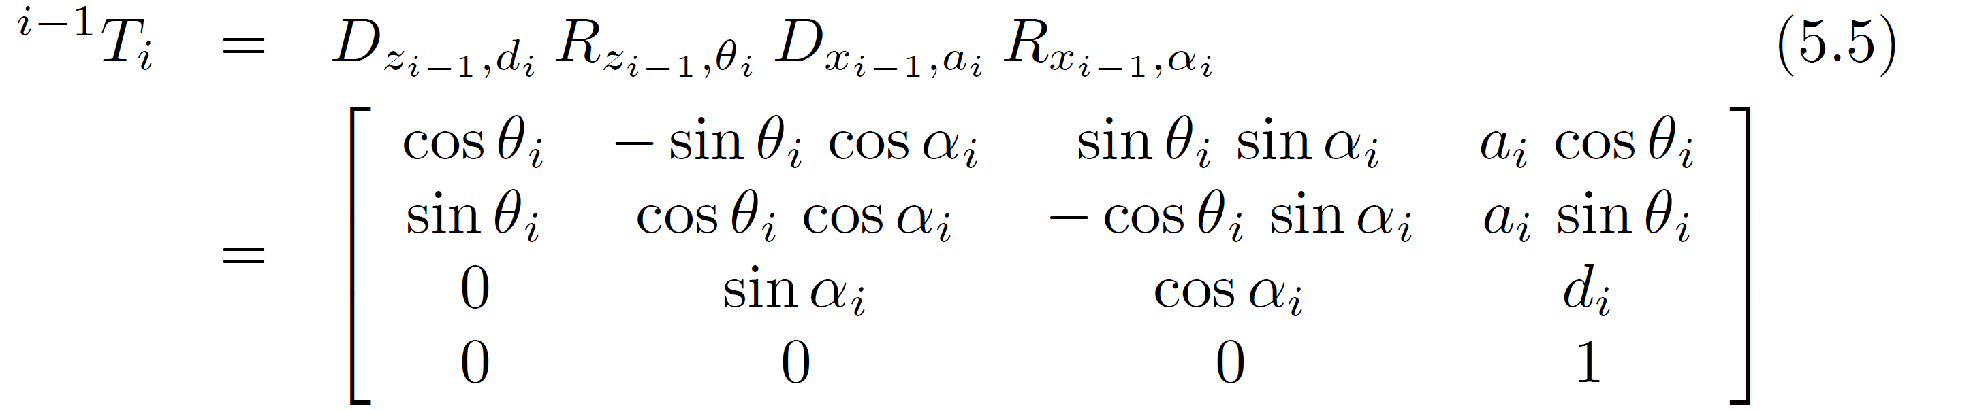
Translation between two adjacent frames from frame B_{i} to B_{i-1}
If a translation D and a rotation R are along and about the same axis, it does not make a difference to apply D first and then R or vice versa. Therefore

Slide 15
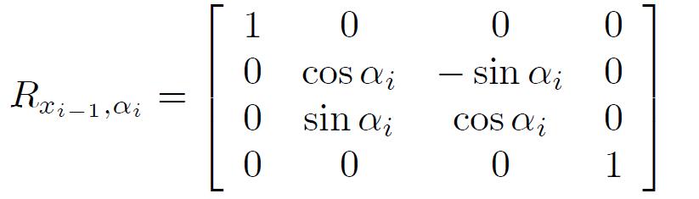
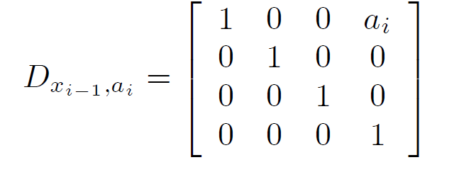
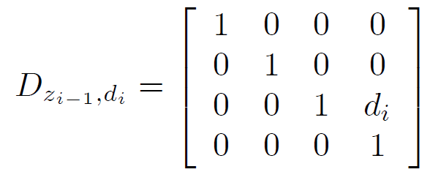
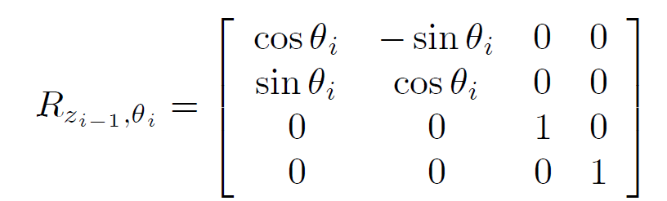

Slide 16
Rules of assigning frames
Assign Z_{i-1} to the actuation of joint i.
Axis of revolution of revolute joint
Axis of translation of prismatic joint
Assign Xi so that
Derive axis Y from on X and Z following right hand rule.

Slide 17
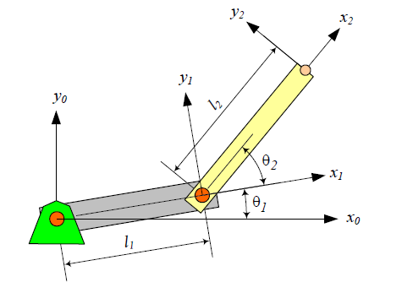
Example: DH parameters The two links arm
Base frame O₀
All Z axes are normal to the page
link | a_{i} | α_{i} | d_{i} | θ_{i}
1 | l1 | 0 | 0 | θ₁*
2 | l2 | 0 | 0 | θ₂*
* variable

Slide 18
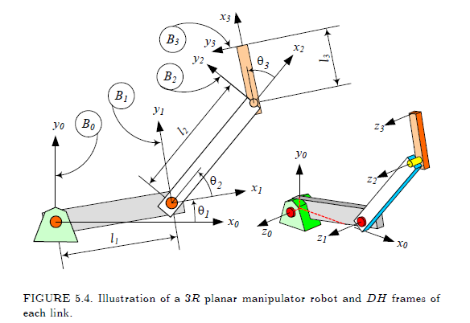

Example: DH parameters The three links arm

Slide 19
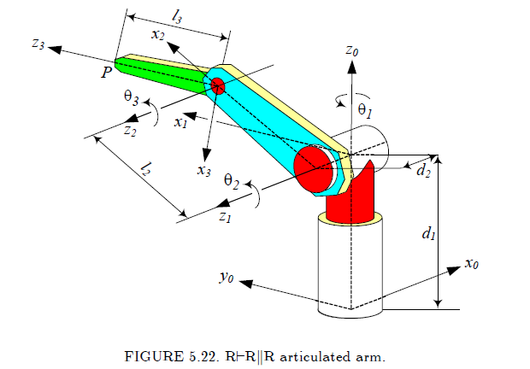
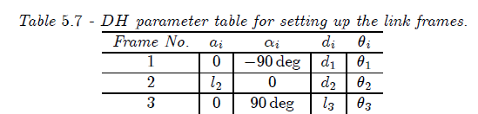

Slide 20
Homogeneous Transformation Matrix for different types of links
Each joint can be P or R; the axes of two adjacent joints can be parallel ||, orthogonal ├, or perpendicular ⊥.
Two orthogonal joint axes ├ interest at a right angle; Two perpendicular joint axes ⊥ are at a right angle with respect to their common normal.

Slide 21
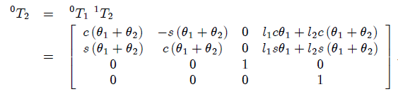
R||R manipulator
link | a_{i} | α_{i} | d_{i} | θ_{i}
1 | l1 | 0 | 0 | θ₁*
2 | l2 | 0 | 0 | θ₂*

Slide 22
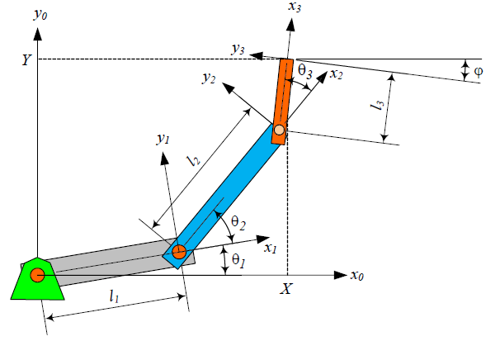
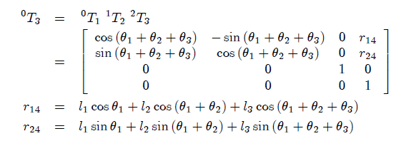
R||R||R

Slide 23
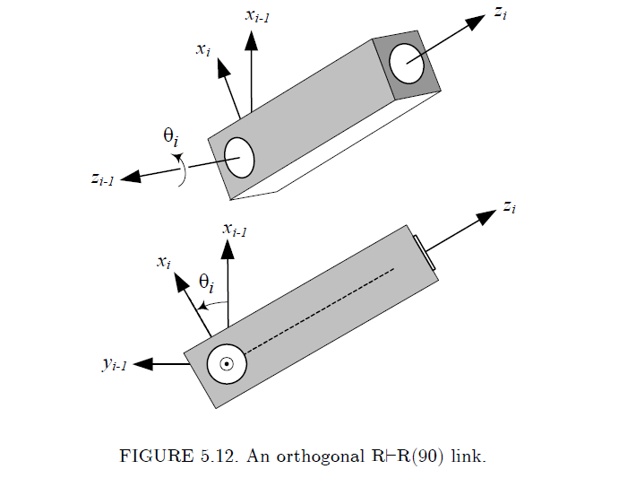
Orthogonal joints
Z_{i} and Z_{i-1} are at right angle and are intersecting
Keep in mind: the proximal frame i-1 is the reference (global) frame in the transformation ^{i-1}T_{i}

Slide 24
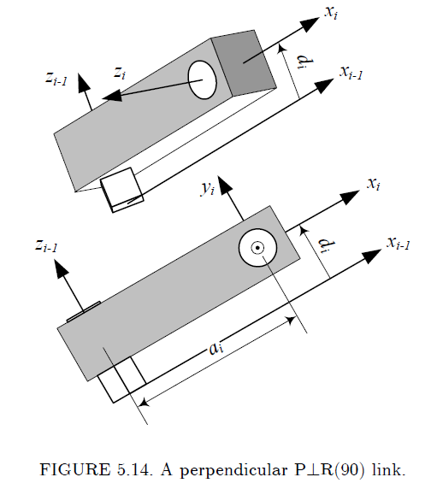
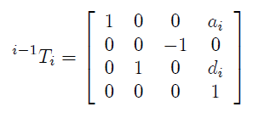
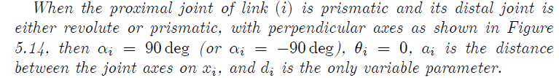
Perpendicular joints

Slide 25
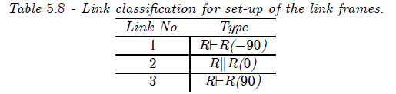

Slide 26
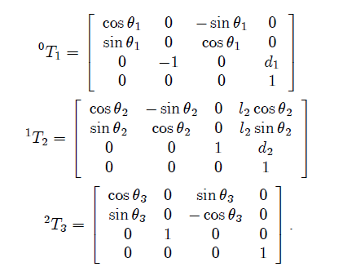

Slide 27
References
Textbook: Theory of Applied Robotics -Kinematics, Dynamics, and Control (2nd Edition). Jazar, Reza N.

